Slide 1
Job Performance & Job Analysis
Chapter 4
1 | 2 | 3 | 4 | 5 | 6 | 7 | 8 | 9 | 10 | 11 | 12 | 13 | 14 | 15 | 16 | 17 | 18 | 19 | 20
21 | 22 | 23 | 24 | 25 | 26 | 27 | 28 | 29 | 30 | 31 | 32 | 33 | 34 | 35 | 36 | 37 | 38 | 39 | 40
41 | 42 | 43 | 44 | 45 | 46 | 47 | 48 | 49 | 50 | 51 | 52 | 53 | 54 | 55 | 56 | 57 | 58 | 59 | 60
61 | 62 | 63 | 64 | 65 | 66 | 67 | 68 | 69 | 70 | 71 | 72 | 73 | 74 | 75 | 76 | 77 | 78 | 79 | 80

Slide 2
Overview
Modules 4.1 & 4.2 – Job Performance
Module 4.3 – Job Analysis Fundamentals
Module 4.4 – Newer Developments in Job Analysis
Module 4.5 – Job Evaluation & the Law

Slide 3
Modules 4.1 & 4.2 – Job Performance

Slide 4
Basic Definitions
Performance: Actions or behaviors
Effectiveness: Evaluation of results of performance
Productivity: Ratio of effectiveness (output) to cost of achieving that level of effectiveness (input)

Slide 5
Campbell’s Model of Job Performance (JP) Determinants
3 Direct Determinants of JP
Declarative Knowledge (DK)– understanding what is required to perform a task
Procedural knowledge & skill (PKS)– know how to perform a job or task; developed through practice and experience and leads to automaticity - (can do job without thinking about it)
Motivation (M) – concerns the conditions responsible for variations in intensity, persistence, quality, and direction of ongoing behavior

Slide 6
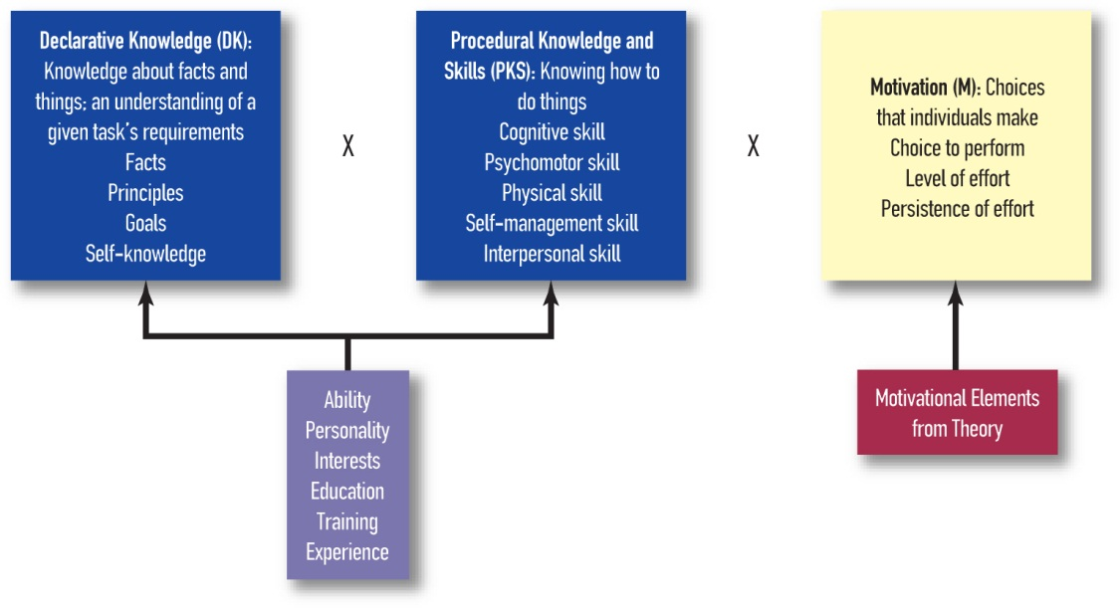
Campbell’s Determinants of Job Performance
Figure 4.1. SOURCE: Based on Campbell, McCloy, Oppler, & Sager (1993).

Slide 7
Components of Job Performance Cont’d
3 components essential for every job
job-specific task proficiency
demonstrating effort
maintaining personal discipline

Slide 8
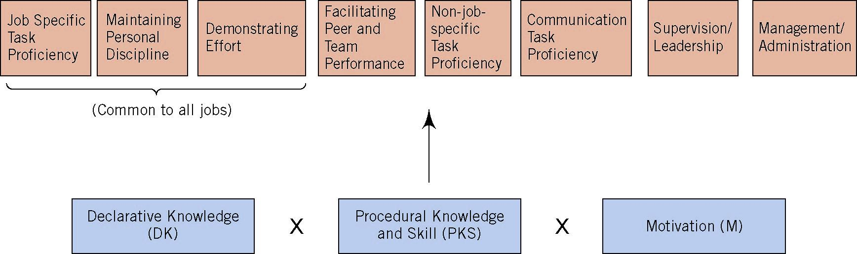
Full Campbell Model
Figure 4.2. Source: Based on Campbell, McCloy, Oppler, & Sager (1993).

Slide 9
Typical vs. Maximum Performance
3 characteristics of maximum performance situations. Individuals are:
Aware that they are being evaluated
Accept instructions to maximize effort
evaluated over a short time period
Research Shows:
Goal setting can induce maximum performance
Low confidence undermines maximum performance
Cognitive ability predicts maximum performance whereas motivation & personality predict typical performance

Slide 10
Extensions of the Basic Performance Model
Organizational Citizenship Behaviors (OCBs)
Counterproductive Work Behaviors (CWBs)
Adaptive Performance
The “Great Eight” Competencies
Expert Performance

Slide 11
Task Performance vs. Organizational Citizenship Behaviors
Task Performance
VS.
OCBs
Doing just what is expected
Formally recognized as part of the job
a.k.a., “citizenship performance”; “contextual performance”
Going beyond what is expected
Performance that supports the organizational, social, and psychological environment in which the job tasks are performed

Slide 12
Task Performance vs. Organizational Citizenship Behaviors
Task Performance
VS.
OCBs
Requirements vary from job to job
Individual differences tied to abilities & knowledge
Activities part of job description
Common to most jobs
Individual differences tied to personality
Activities often not part of job description
Supports organizational environment

Slide 13
OCB – Three Categories
Personal Support
Helping others
Coopering with others
Showing consideration, courtesy to others; motivating others
Organizational Support
Representing the organization favorably
Supporting the organization’s mission → rule compliance, suggesting improvements
Conscientious Initiative
Persisting with extra effort
Taking initiative
Developing self-knowledge and skills

Slide 14
OCB Cont’d
Do OCBs predict organizational or unit level performance?
Yes Podsakoff el al, (2009) conducted a meta analysis linking cbs to common places
Has greater level of efficiency's, lower cost, reduced turnover, best customer servicer
Increasing importance in today’s workplace
Global competition will require more effort from employees
Teams are more common now
Downsizing requires adaptability & extra effort
Customer service increasingly important

Slide 15

The Dark Side of Performance
Counterproductive work behaviors (CWB)
Voluntary behavior violating significant organizational norms & threatening the organization, its members, or both
Interpersonal deviance – directed towards other individuals
Organizational deviance – directed at the organization

Slide 16
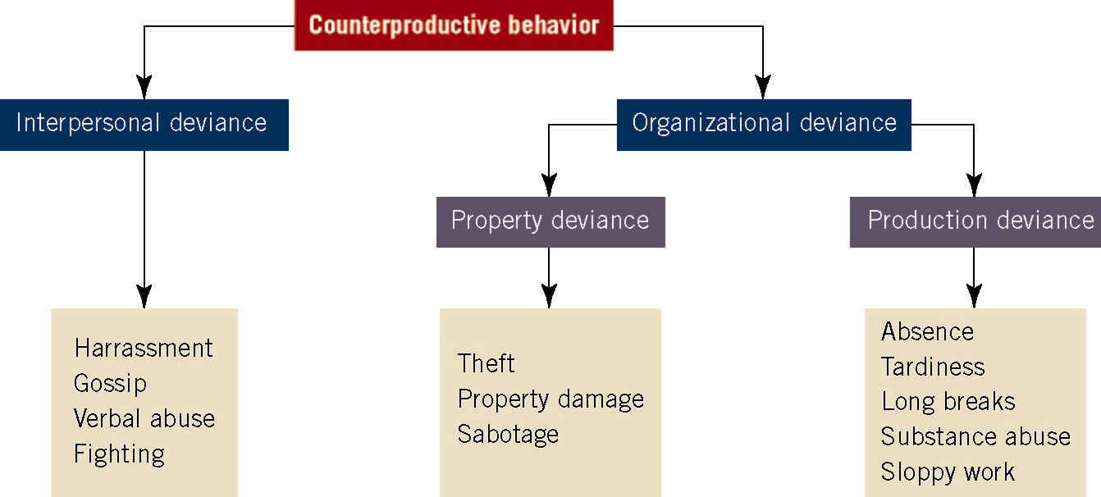


Hierarchical Model of CWBs (Sackett & DeVore, 2001)

Slide 17
Causes and Treatments of CWB
Personality factors seem to be most closely associated with CWB
The situation– feelings of injustice, individual need, opportunities to steal, etc.
Colbert et al. (2004) – employees high on conscientiousness and agreeableness, who like their work situation, are least likely to engage in CWB

Slide 18
Adaptive Performance
Beneficial due to changing nature of work
Changing technologies alter work tasks
Mergers, downsizing, and corporate restructuring
Globalization & working in different cultures
Pioneered by Pulakos and colleagues

Slide 19
Components of Adaptive Performance
Handling emergencies or crisis situations
Handling work stress
Solving problems creatively
Dealing with uncertainty and unpredictability
Learning work tasks, technologies, and procedures
Demonstrating interpersonal adaptability
Demonstrating cultural adaptability
Demonstrating physically oriented adaptability

Slide 20
Bartram’s (2005) “Great Eight” Competencies
Leading and deciding
Supporting and cooperating
Interacting and presenting
Analyzing and interpreting
Creating and conceptualizing
Organizing and executing
Adapting and coping
Enterprising and performing

Slide 21
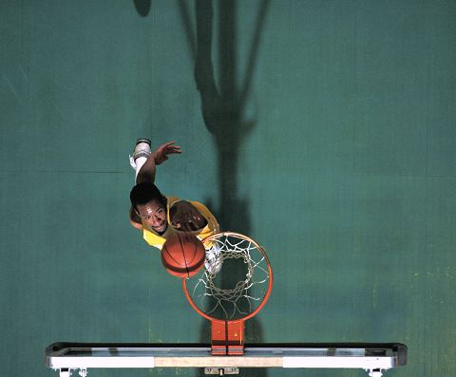
Expert Performance
Performance exhibited by those who have practiced for at least 10 years & have spent an average of 4 hours/day in deliberate practice
Deliberate practice
Individualized training on tasks selected by a qualified teacher
Thoughtful practice

Slide 22
The Criterion Problem
What is the criterion?
Job performance
Why is this important?
To find out what performance will be later on
How do we define criteria?
Ultimate vs. actual criterion
Beware of contamination and deficiency

Slide 23
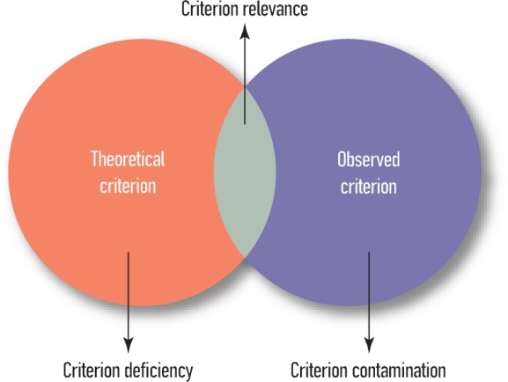
Contamination and Deficiency
Ultimate criterion
Actual criterion
- Anything we measure but is not supposed to be there

Slide 24
Examples
Supervisory ratings – most common; usually deficient because supervisor isn't always there, often contaminated because of feelings toward you, political agendas.
Customer ratings
Number of widgets produced (quantity)
Widget quality
Combination of quantity and quality
Widget quantity/quality during a test
Absenteeism
Training post-test
Team performance ratings

Slide 25
Development of Criteria
Major problem for HR
Which criterion do we choose?
Job performance is neither effectiveness nor productivity
Confounded by situational factors
Determinants versus components of JP
Campbell (1990) model

Slide 26
Desirable Criteria
Well-defined / specific
Reliably measured – necessary but not sufficient
Practical – has to be easy enough for the person to do, feasible
Relevant (valid)
No contamination – don’t measure things we shouldn't
No deficiency – make sure we measure all thing needed
Long-lasting? – can this last overtime and can we maybe relate this to pay (if company wants)

Slide 27
Types of Criteria
Objective
Examples
Sales, turnover, tenure, absence, accidents, theft
Subjective
Examples
Supervisory ratings, peer ratings, self-evaluations, customer evaluations
Someone else is rating or you are rating yourself

Slide 28
Module 4.3 – Job Analysis Fundamentals

Slide 29
What exactly is involved in a job? (i.e. How do we define a job?)
What about Student?
Study, grades
What about Psychology Instructor?
Teach, grade assignment, create lesson plans, office hours,

Slide 30
Job Analysis
Process that determines the important tasks of a job and the human attributes necessary to successfully perform those tasks
Is the “building block” of IO Psychology
Ways that job analyses differ:
Why?
Who?
How?
What?

Slide 31
Job Analysis – Why?
Job Analysis
Performance Assessment
Job Description
Training
Selection
Promotion
Compensation
Criterion Development
Legal Defense
Recruiting
Job Design
Workforce Reduction

Slide 32
Job Analysis – Who?
SME = Subject Matter Expert
An expert on the subject matter!
usually many people
Common SMEs
Supervisor
Job incumbent – employee in the job
Job analyst

Slide 33
Job Analysis – How?
Observation
Interview/Focus Group
Critical Incidents/Work Diaries –( log over a week to see what employee is doing)
Specific, focuses on observable behavior, describes context and outcome
Questionnaires
Historical Data – usually where you start
DOT and ONET (http://online.onetcenter.org)

Slide 34
Job Analysis – What?
Task-Oriented Job Analysis
Identifies all tasks done on the job; not geared toward finding characteristics
Worker-Oriented Job Analysis
geared toward what characteristics are need in a worker for a job

Slide 35
Task-Oriented Job Analysis
General approach – Define a job based upon the behaviors that job involves (i.e. what the worker accomplishes)
Sample Subtypes
Task Inventory
Functional Job Analysis (Data/People/Things)
Result – Extremely detailed, specific description of what a job involves
Problems
Lack of flexibility
Difficult to compare across jobs
Unsuitable for selection

Slide 36
Task-Oriented Job Analysis – Task Inventory Example
Write a task statement for each task performed on the job
Task statement format:
Part 1: What does the worker do (an action verb)
Part 2: To whom or what he or she does it (object of the verb)
Part 3: What is produced (outcome of the action)
Part 4: What materials, tools, procedures or equipment are used

Slide 37
Task-Oriented Job Analysis – Task Inventory Example
Position: Firefighter
Example task statements
Piles and covers furniture, clothing, and other valuables for potential salvage using fire and water proof covers
Examines walls, ceilings, floors, and furniture for structural damage using appropriate tools
Carries smoldering mattresses and furniture from buildings using physical strength, furniture dollies, and or moving bins
Tasks are put in a questionnaire and rated according to their importance, frequency, time spent, difficulty of learning

Slide 38
Task-Oriented Job Analysis – Functional JA Example
Position: Firefighter
Duty: Respond to emergency dispatches
Task 1: Perform salvage and overhaul
Categorization: low data, low people, high things
Piles & covers ➢ furniture, clothing, & other valuables
Examines ➢ walls, ceilings, floors, & furniture
Carries ➢ smoldering mattresses & furniture from buildings

Slide 39
Worker-Oriented Job Analysis (KSAO-approach)
General approach – Define a job based upon the attributes of the worker necessary to accomplish tasks on the job
Typical Measure
Position Analysis Questionnaire (PAQ)
Result – General behavior descriptions allowing comparisons across many types of jobs
Problems
Lack of specificity in description

Slide 40
KSAOs
Knowledge – collection of discrete, related facts & information about a particular domain
Skill (e.g., computer or interpersonal skills)– practiced act – easier to practice – like typing or riding a bike for a job
Ability – stable capacity to engage in a specific behavior – relatively stable hard to change aspects
Other characteristics: interests, personality, etc.

Slide 41
Worker-oriented Job Analysis example
Elicit KSAOs using the Critical Incident Technique
Think of a recent situation in which you observed a firefighter doing something especially effective/ineffective.
What led to this performance? (timeline)
What did the person do? (specific)
What happened as a result? (effectiveness)

Slide 42
Worker-Oriented Job Analysis Example
Position: Firefighter
Duty: Respond to emergency dispatches
Knowledge
Mechanical – Knowledge of fire fighting tools, including their design, uses, repair, and maintenance
Abilities
Complex problem solving – Identify complex problems and review related information to develop and evaluate options and independent solutions

Slide 43
Module 4.4 – Newer Developments in Job Analysis

Slide 44
Newer Developments in Job Analysis (JA)
Electronic performance monitoring
Can be cost effective & provide detailed, accurate work log
e.g., “This call may be monitored for quality control purposes.”
Cognitive Task Analysis
Utilizes think-aloud protocol to elicit mental processes and knowledge content
Expensive, time consuming, and requires considerable expertise
Competency Modeling
Process that identifies desired characteristics across all people and jobs in an organization
Top down version of JA
Analyzes (1) top performers or (2) values of an organization

Slide 45
Occupational Information Network (O*NET)
Introduced by federal government to replace the Dictionary of Occupational Titles (D.O.T.)
Collection of electronic databases, based on well-developed taxonomies
Electronic medium, so it can be updated instantaneously as changes occur

Slide 46
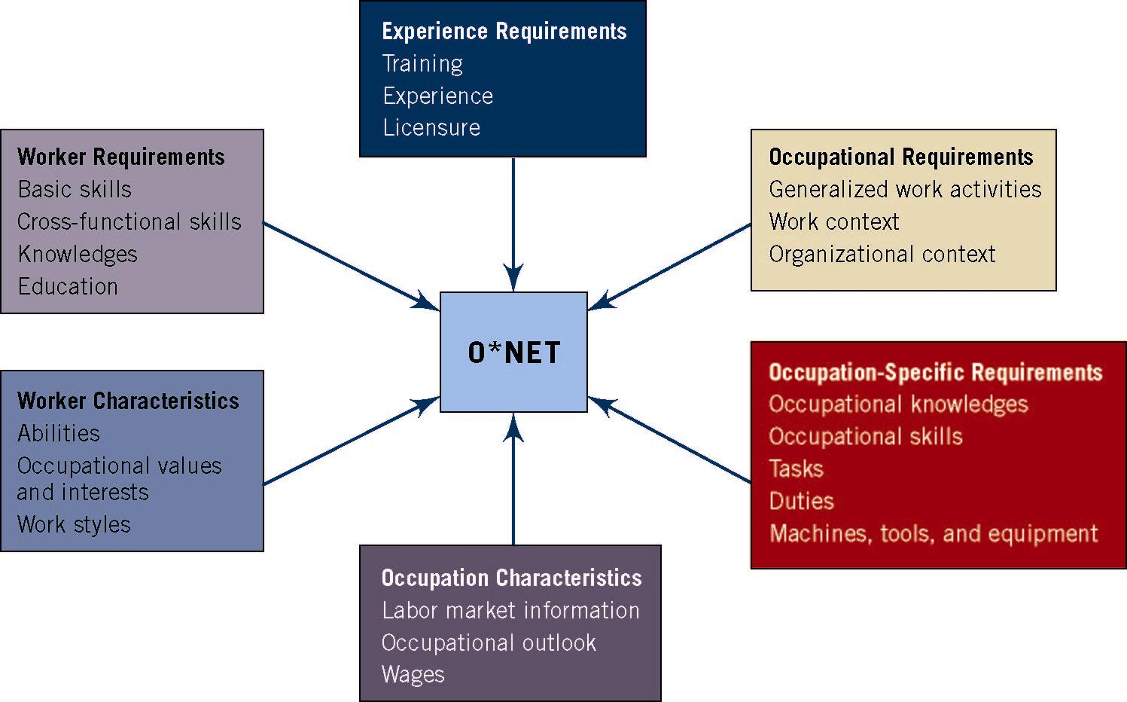
O*NET Data Bases
Data Bases Forming the Foundation for O*NET
Source: Mumford & Peterson (1999).

Slide 47
Potential distorting influences in JA
Need of subject matter expert (SME) to conform to what others report
Desire to make one’s job look more difficult
Attempts to provide answers that SME thinks job analyst wants
Carelessness

Slide 48
Module 4.5 – Job Evaluation & The Law

Slide 49
Job Evaluation, Comparable Worth, & the Law
Job evaluation: Method for making internal pay decisions by comparing job titles to one another & determining their relative merit
Compensable factors
Skills, responsibility, effort, & working conditions
Equal Pay Act of 1963 – required “equal pay for equal work.”
Lilly Ledbetter Fair Pay Act of 2009 – reinforced 1963 act

Slide 50
Comparable Worth
Notion that people who are performing jobs of comparable worth to an organization should receive comparable pay
In the end, comparable worth is concerned with the social value of fairness

Slide 51

Job Analysis & Employment Litigation
Competent job analysis does not guarantee validity, but absence of credible job analysis could be very damaging
Growing gap between evolution of I-O psychology & Uniform Guidelines on Employee Selection Procedures (1978)
SIOP Principles (2003) are more updated and consistent with current research

